Slide 1
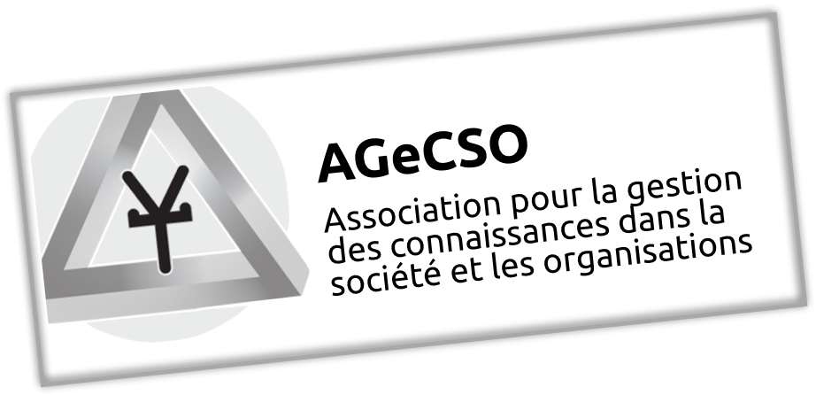
Projet BourbaKeM
Elément n° 13 :
Innovation et connaissances
Danièle CHAUVEL
Notes:
1

Slide 2
Innovation
L’Innovation est
… une façon d’organiser l’activité humaine autour du développement de quelque chose de nouveau avec création de valeur
… un trait fondamental de l’être humain (Simpson, 20021)
… la source organisationnelle pour la croissance et le futur gagnant (P Howitt , 20002)
…. Un processus complexe et chaotique
1 - Simpson, B.M. (2002) ‘The knowledge needs of innovating organisations’ The Singapore Management Review, Vol. 24 , N° 3,pp. 51-60
2 - Howitt P. (2000), The Economics of Sciences and the Future of Universities. The 16th Timlin Lecture, delivered February 16, 2000 at the University of. Saskatchewan
Notes:
- not a new phenomenon; it dates from the ascent of humankind
- we can define it as a way to organize human activity around the development of something new with embodied value added.
- it is a defining feature of human society, a source of advancement and development, of economic and societal prosperity through all civilizations. Today, it has become the focus of attention and the top priorities of organizations willing to survive and remain competitive in the knowledge/creative economy.
- Literature is prolific about this manifold concept with different characteristics (radical, incremental, open, closed…) , formats (product, process, strategy, marketing, …), views (process or outcome), theories….
- yes, multiple and various meanings are couched in the term innovation which is recognized as a complex and chaotic process. However, all are concerned with novelty and value creation

Slide 3
Innovation
Facteur clé pour le progrès et le devenir
Des changements essentiels dans sa nature, ses dimensions, ses attributs
Le fait que de nouvelles idées peuvent transformer tout maillon de la chaîne de valeur est maintenant reconnu,
« l’ innovation est devenue la responsabilité de toute l’organisation.” » (Birkinshaw et al, 2011, p.433)
3 - Birkinshaw, J., Bouquet, C. and Barsouxet J.-L. (2011) ‘The 5 Myths of Innovation’ MIT Sloan Management Review, Vol.52, N°2 pp. 43-50
Notes:
In Knowledge economy, innovation is more important than ever and is considered a key factor for survival and progress, even if its basic nature has profoundly changed together with its dimensions and attributes.

Slide 4
L’innovation, un concept évolutif
Chauvel, 2013
Notes:
This table presents a summary of main changes affecting the innovation concept over the path from industrial to knowledge era, resulting from a comparative analysis of several theories, models and perspectives on innovation …
In the Knowledge era, we see a new nature of innovation, with a new balance between technology-driven, competitive driven and user-driven innovation – with much more emphasis on the users.
Innovation is seen not as episodic but interactive, iterative and continuous.
From a traditional “firm centric view”, we move to a “personalized, co-created view” of innovation with the centrality of the individual.
Innovation applies to products, processes, …
Co- creation, tapping hidden knowledge from users, global knowledge sourcing and innovation partnerships are drivers of innovation; designing new solutions to meet growing global challenges is also a driver for innovation as well as the concern for social responsibility;
New solutions can often be created by existing technology or new combinations of existing technology where technology is not the driver
of innovation but the enabler.
In terms of scope, it is more democratization & openness and in the context rules of the game are often changing
Today, models of innovation are interactive, implying both a social and technical process and based on the fact that …

Slide 5
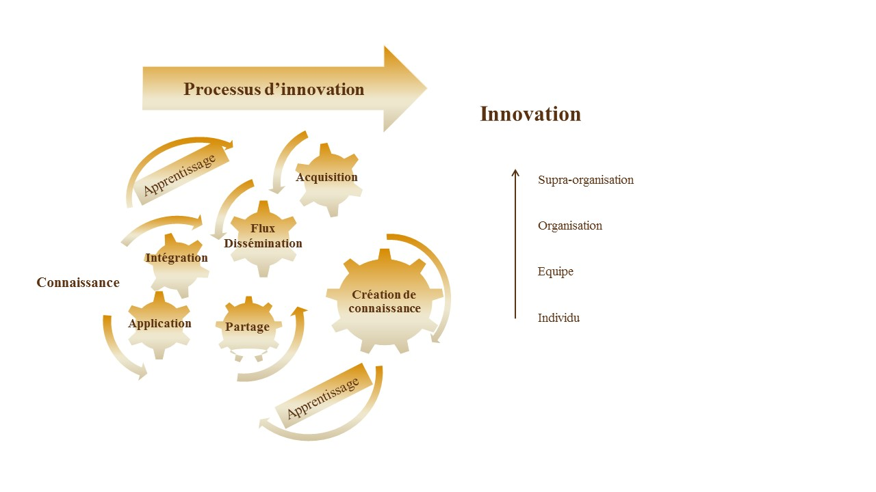
L’innovation, un processus lié étroitement à la connaissance
Une « spirale » d’innovation durable :
Les nouvelles connaissances issues de ce cycle de transformation de connaissances et de création d’innovation sont reversées dans la base de connaissances organisationnelle et ainsi l’alimente.
Chauvel, 2013
Notes:
It is essentially about knowledge, the outcome of a set of activities through k acquisition, k flow, k integration and K application resulting in knowledge creation with a lot of feedback loops between the different stages.
Through learning processes at the individual, group & organizational level, K is created and new knowledge resulting from innovation is fed back into the organization knowledge base, this feedback loop contributes to the Sustainability of the process.
Innovation is, indeed, a k intensive business process, resulting from a complex linkages between actors creating and distributing various kinds of knowledge. Its performance depends on the way these actors relate to each others as elements of a collective system of knowledge creation and use

Slide 6
Principaux leviers de l’innovation comme processus de KM
Interne & externe
Aptitude à l’apprentissage
Curiosité& ouverture
Connectivité
Flux de connaissance et empathie
Dynamique synergies & co-création
Ecoute, respect et confiance
Responsabilité & engagement
Collaboration
Intelligence distribuée
Penser autrement
Cross-fertilisation
Comportement ouvert et flexible
Tolérance
Diversité
Notes:
What happens? Literature says it is social mechanisms among individuals and organizations that initiate and sustain processes related to innovation. Five main social mechanisms are identified: connectivity, collaboration, knowledge diversity, collective creativity and creative leadership.
connectivity: Connectivity is the most important prerequisite for innovation: it constitutes a robust indicator of the learning and innovation ability and favors curiosity and openness.
Internal connectivity is an expression for a shared value system, shared visions, shared mental models and knowledge based on experience
collaboration: Collaboration facilitates the link between various types of knowledge, encourages dynamic synergies & co-creation. it is based on respect and trust.
diversity: Involving networks of actors with very different perspectives, interests, and cultures spanning different levels is taking advantage of the knowledge diversity. this cross fertilization through distributed knowledge enhances the capabilities of thinking differently.
Inviting several thousands of different participants in the JAM process means stimulating connectivity inside and outside the company, encouraging collaboration and taking advantage of knowledge diversity.

Slide 7
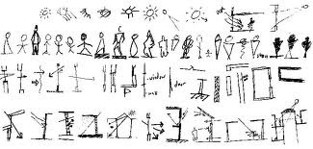
Principaux leviers (suite)
Créativité collective
Liberté et expression libérée
Donner du sens au rôle d’acteurs
Climat social propice: prise de risque, agilité et apprentissage
Responsabilité collective & engagement
Aptitude à créer un climat innovant
Donner du sens au futur
Prise de risque et agilité pour faire face à l’incertitude
Leadership créatif
Notes:
Collective creativity
JAM is asking to go beyond existing knowledge, fostering collective creativity: Breaking down with routines and institutional habits, it liberates freedom and freewheeling expression, opening avenues to unlock creativity and to think inventively.
Collective creativity makes sense of the role of actors and depends on a propitious social climate, made of risk taking, agility, error acceptance, learning culture and responsibility
Creative leadership
This requires creative leadership to create innovative climate and make sense of the future. Creative and supportive leadership means risk taking and agility to face uncertainty.
Jam facilitators help participants to build on each other’s ideas, they are attentive to the debate, listening weak signals to develop new perspectives.
Innovation was produced and supported by interconnected social mechanisms which deploy a K intensive process

Slide 8
Innovation, un phénomène social
Un processus intimement lié à la connaissance
Mécanismes sociaux comme leviers
Etres humains
au centre comme acteurs
L’innovation durable s’accompagne de nouvelles capacités managériales pour créer des conditions favorables
➔
Capacités pour apprendre et développer efficacement
Capacités d’intégrer les différentes connaissances et perspectives pour agir avec agilité
Réseautage et socialisation
Pensée créative
➔
Notes:
This perspective allows to consider innovation as a social phenomenon because it is a manifestation of the capability of the firm to exploit knowledge innovatively, and K is something that only people have, can develop, use and maintain through interactions with others and innovation depends on the quality of these interactions.
We see innovation as a knowledge intensive process, activated by human, social and organizational mechanisms which put human beings at the center as actors.
so,
This determines new attitudes & managerial capabilities which are identified as ….
These attitudes and capabilities, issued from the analysis of the innovation process through a k perspective, at the same time stimulate innovation and create favorable conditions

Slide 9
L’innovation durable
Rendre l’innovation durable
la durabilité de l’acte d’innovation de par sa dimension humaine et sociale
la durabilité de l’acte d’innovation, avec durabilité sur le long terme, sens en accord avec les ressources humaines en jeu, et cohérence avec le présent et le futur
Interaction sur une base mutuelle et continue , pour préserver à la fois la durabilité de l’innovation et de l’organisation
Notes:
At the beginning of my presentation, I said that :
we consider, the sustainability of the innovation act and its outcomes, their potential long term durability, sense making and consistence with today world as well as for the future leveraging progress and value creation.
I have also mentioned the interaction ( and not the exploitation) of the organization with the environment and society on a mutually beneficial and ongoing basis, preserving sustainability in both innovations and organizations. This is accomplished by knowledge creation
To conclude with the JAM example, it is accomplished by knowledge creation through connectivity, cognitive diversity, creative thinking and learning capability. Results meet these requirements of potential long term durability, sense making and consistence with today world as well as for the future leveraging progress and value creation as we see in the Smarter Planet initiative.

Slide 10
Projet BourbaKeM
Elément n° 13 :
Innovation et connaissances
Merci pour votre attention
Notes:
10

